Slide 1

Data Curation Project on Divvy Bike Rides
Shriya Prasanna
Girish Rajani
Subramanya ganesh

Slide 2

Divvy Bike Rides Dataset
September and October 2023 Divvy Bike Rides history data retrieved from Index of bucket "divvy-tripdata"
Chose this dataset to find out:
Number of rides per month
Member riders vs Casual riders
Find the busiest days of the week based on avg trip time per day
Datasets consists of → 13 attributes →.csv format → over 1 million records

Slide 3
Overview of Workflow & Problems In Data Quality
Data Collection
Merged Dataset
Data Cleaning
Data Transformtion
Data Visulization
Using Pandas Package
If Null values existed ? YES
Date format
Casual vs Member riders.
Data Collected from Divvy Bikes
The data sets were vertically concatenated.
Calculated the Trip Time
If duplicates existed ? NO
Type of Bike riders per Member-causal
Zip files from AWS bucket
* Split the data files into 2 half’s and then loaded into vizier
Sept file -1
Sept file 2
Oct file-1
Into 1 dataset
Data format check, Date format was in dd-mm-yyyy mm:ss
Check for Outliers ? YES
Riders per month
Dropped Unnecessary Columns
Riders Per hour
Average Trip Time per Day

Slide 4
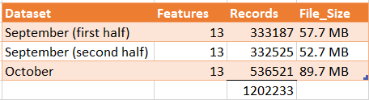
Solving the Data Quality Problems
File size too big greater than 100 MB, problem loading in vizier
Null Values Identified in columns : start_station_name, start_station_id, end_station_name, end_station_id.
Dropped the data for this columns as there was no way to get this information.
1,203,479 to 910415.

Slide 5
Solving the Data Quality Problems
3. Date-Time format was transformed from MM/DD/YYYY to different columns for better understanding of data.
started_hour, started_day, started_month, started_year, ended_hour, ended_day, ended_month, ended_year, Weekend ( Yes /NO)
9 New Columns added
4. Calculated Trip Time ( ended_at - started_at)
Dropped the columns started_at & ended_at

Slide 6
Solving the Data Quality Problems
Handling Outliers:
Any trip time <0 or trip time> 480 is considered as outliers
Dropped the outliers
Include the number of outliers (%)

Slide 7
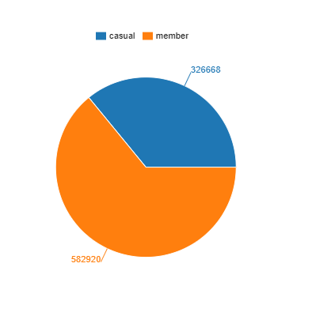
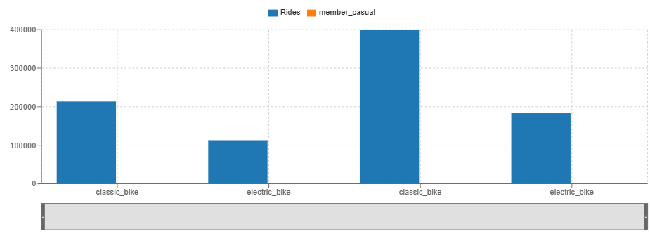
Data Visualization
Casual vs Member riders Pie chat
Type of Bike riders per Member-causal
- Member riders
- Casual riders

Slide 8
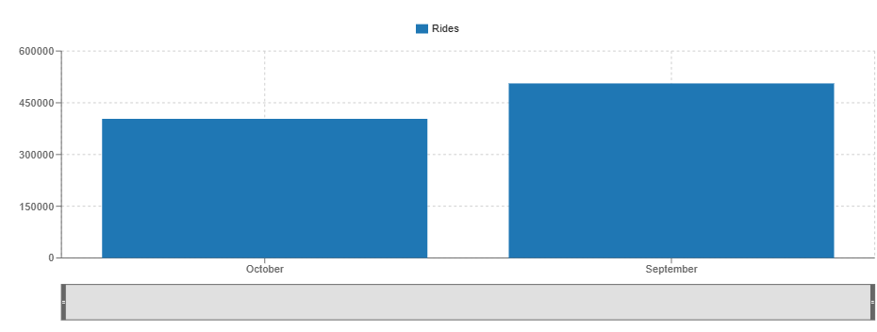
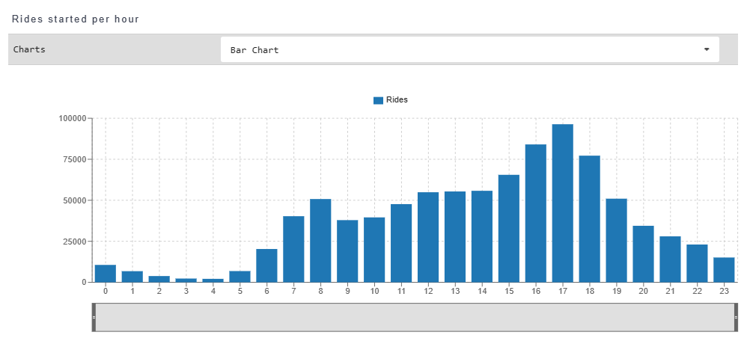
Data Visualization
Rides Per Month
Rides started per hour

Slide 9
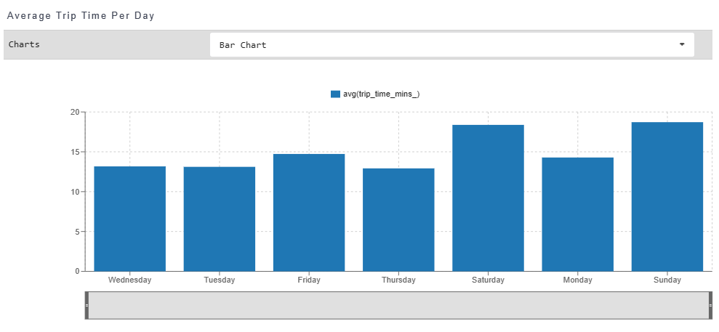
Data Visualization
Average Trip Time Per Day

